Slide 1

GENDER DETECTION & AGE PREDICTION
PRESENTED BY- D17
Neeraj kumar
Suraj prasad
Armaan Arya

Slide 2
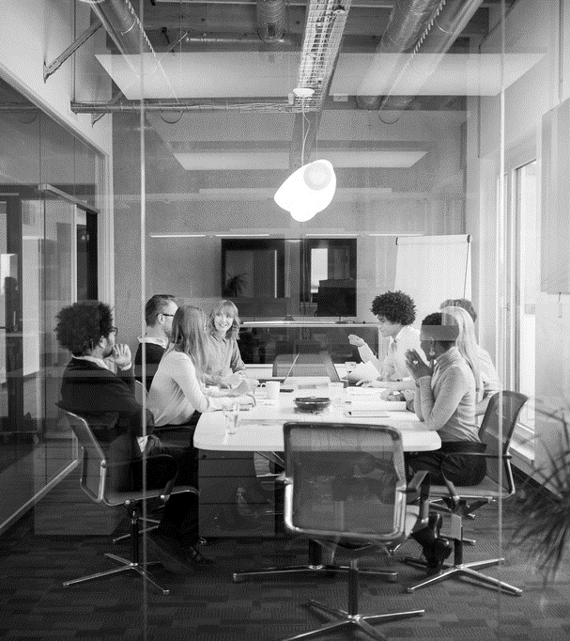
Agenda
INTRODUCTION
TECHNOLOGIES USED
PROCEDURE
APPLICATIONS

Slide 3
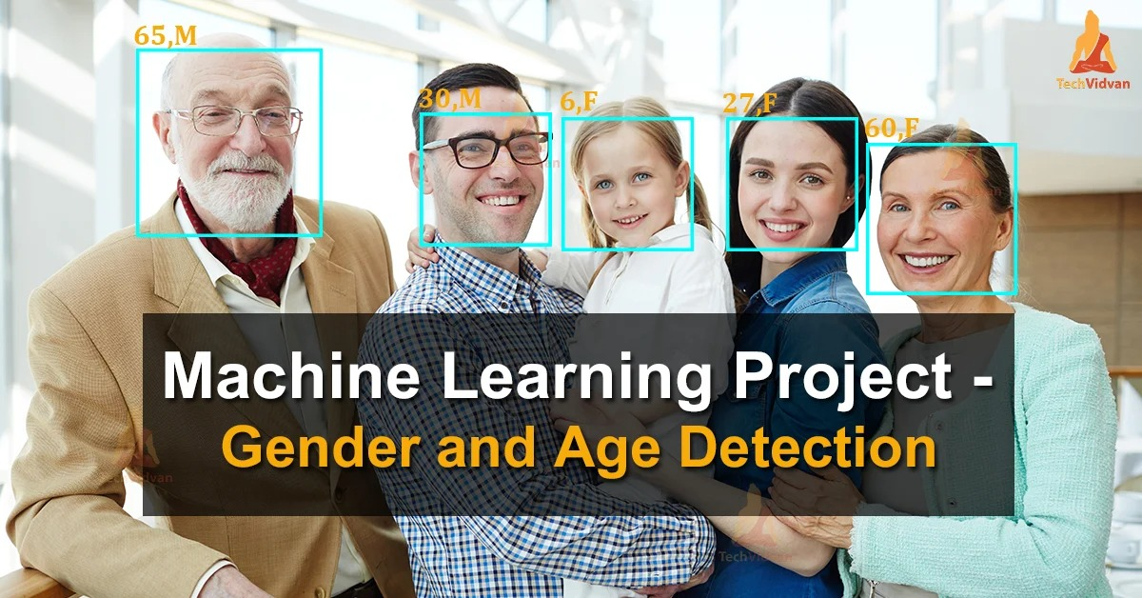
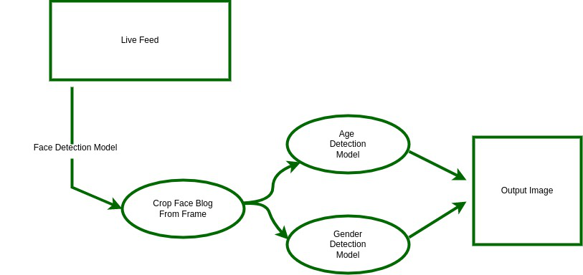
introduction
Gender and Age Prediction from images is an important application of computer vision.

Slide 4


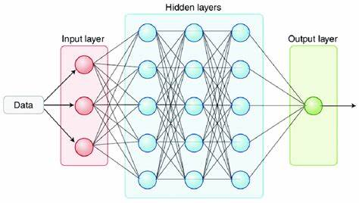
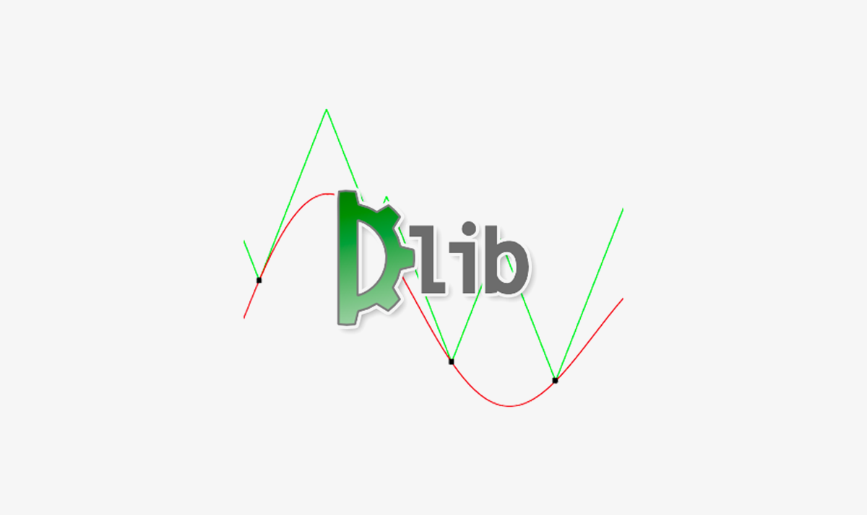

TECHNOLOGIES USED
PYTHON (IDLE)
OPEN CV
DEEP NEURAL NETWORKS
Dlib
NUMPY

Slide 5

What’s next
PROCEDURE

Slide 6

STEPS INVOLVED
DETECT FACES
CLASSIFY INTO MALE / FEMALE
CLASSIFY INTO RANGES
PUT THE RESULTS IN THE FRAME
DISPLAY THE RESULTS

Slide 7
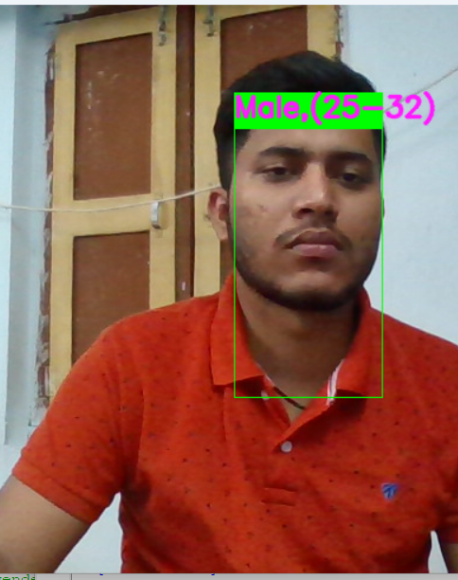
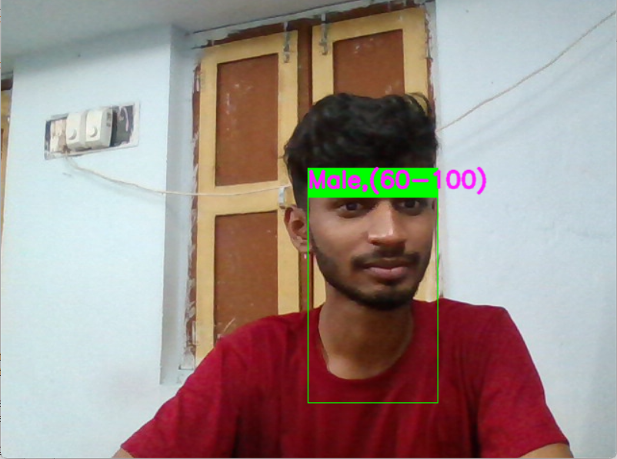
DETECTED FACES

Slide 8
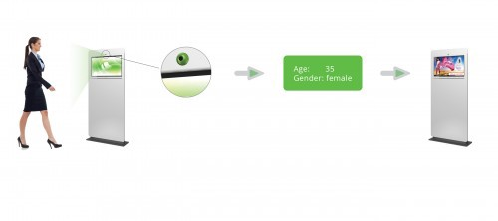
APPLICATIONS
Human gender and age recognition is an emerging application for intelligent video analysis.
In forensic field .
Quividi software .

Slide 9


